Slide 1
Self sustainable electrical cycle
The idea of self sustainable cycle is that it converts and stores the mechanical energy.
SELF-SUSTAINABle CYCLES LET’S US SWITCh FROM MECHANICAL MODE TO ELECTRICAL MODE WHEN REQUIRED by the user,

Slide 2
how do we accomplish to frame an self sustainable electric cycle ?
WE REDUCE THE SCALE OF THE ENTIRE CYCLE INTO A WHEEL FOR THE COMFORT OF PRESENTATION AND THE DEMONSTRATION.
WE WILL CONVERT THE MECHANICAL ENERGY THAT WE ARE USING TO ROTATE THE TYRE TO ELECTRICAL ENERGY BY USING DYNAMO. MOREOVER WE WILL STORE THE ENERGY IN THE BATTERY AND CONSERVE IT.
WE CAN MANIPULATE IT USING DIODES

Slide 3









The components
1)DC MOTOR/DYNAMO(6 AMPERE)
2) DIODE(24 v)
3) RESISTANCE
4) WHEEL
5)SWITCH

Slide 4
WORKING OF COMPONENTS
MOtor:
An electric motor is an electrical machine that converts electrical energy into mechanical energy. Most electric motors operate through the interaction between the motor's magnetic field and electric current in a wire winding to generate force in the form of torque applied on the motor's shaft.
DIODE:
A diode permits electrons to flow from cathode to plate but not from plate to cathode. If an alternating voltage is applied to the plate, current flows only during the time when the plate is positive. The alternating voltage is said to be rectified, or converted to direct current.

Slide 5
working of components
RESISTANCE:
The main purpose of resistor is to reduce the current flow and to lower the voltage in any particular portion of the circuit.
SWITCH:
It has the most basic working which is just to activate and deactivate the whole setup.

Slide 6
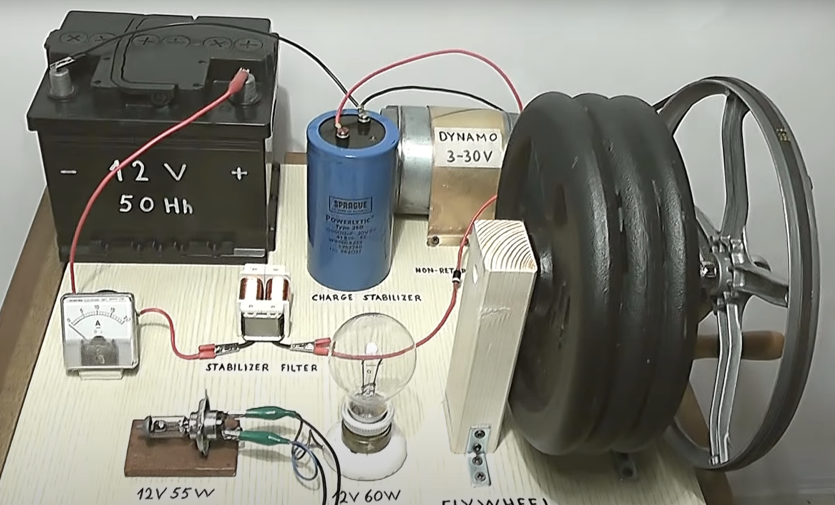
working principle
there is a whole setup where everything is setup on a plank where And we stand the tyre such that we can rotate it manually using a grip and the tyre is connected to motor using conveyor belt such that rotating wheel results in rotation of dynamo/motor.
now when the dynamo is rotated the electricity is produce with 50% effeciency and this electricity is flowed in a direction such that it charges the battery.
diode is connected between in a direction such that it does not allow the current to revert back and then we have the switch besides the battery, which enables us to switch frim mechanical mode to electrical mode in which tyre rotates using the electricity that is stored in battery

Slide 7
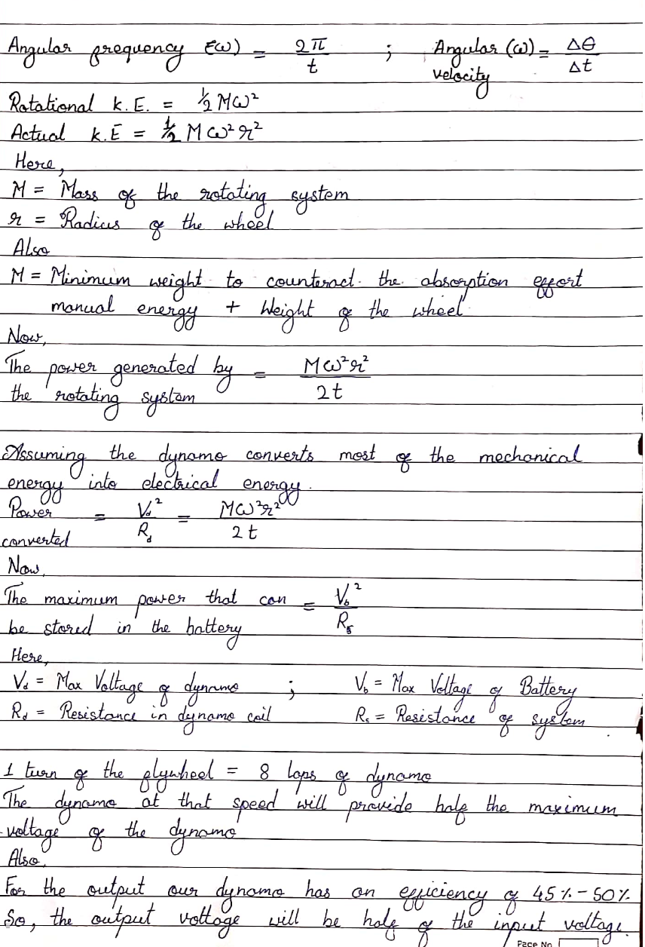

Slide 8

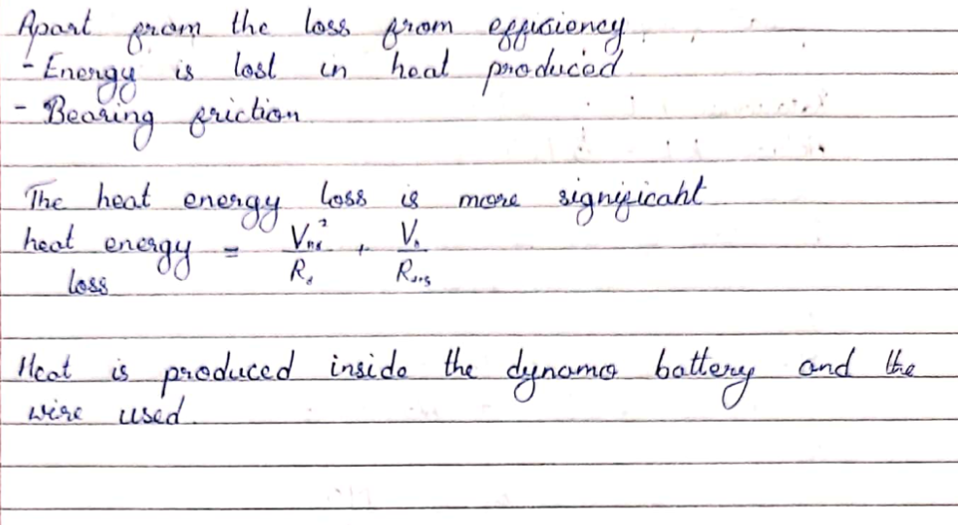

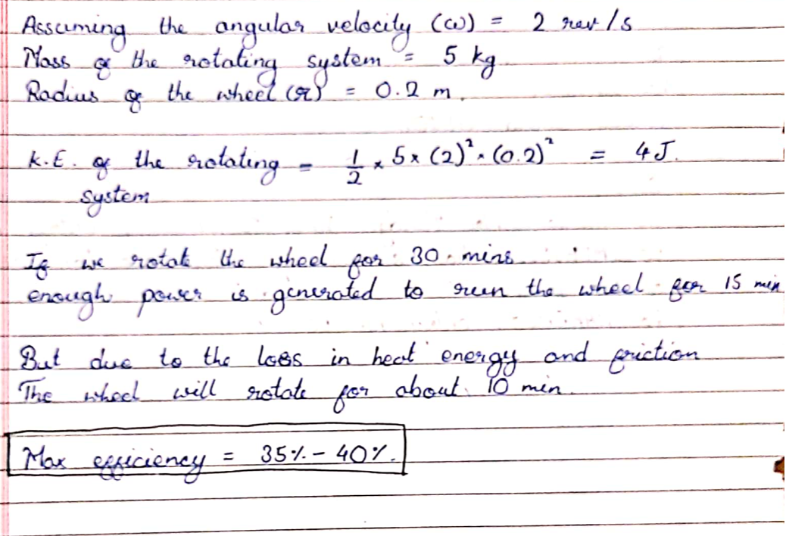

Slide 9
thank you
CREDITS:
Priyanshu
Shivam
Shrey
Vasista
Vipul

